Slide 1
Database Connectivity with ASP.NET

Slide 2
Mr. M.R. Solanki
Sr. Lecturer, Information Technology,
manish_ratilal2002@yahoo.com
SBMP

Slide 3
Learning Outcomes
Students will be able to:
Create ASP.NET project to connect with database

Slide 4
Adding Database into Web Application

Slide 5
ADO.NET
Create a Web application & add database control i.e. SQL Server Database

Slide 6
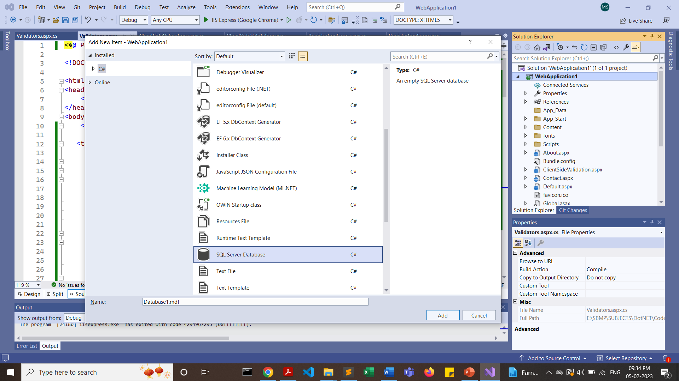

Slide 7
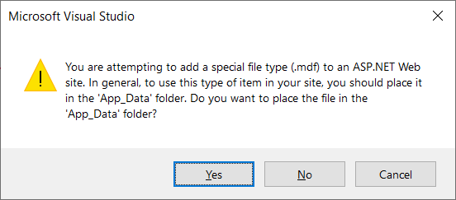

Slide 8
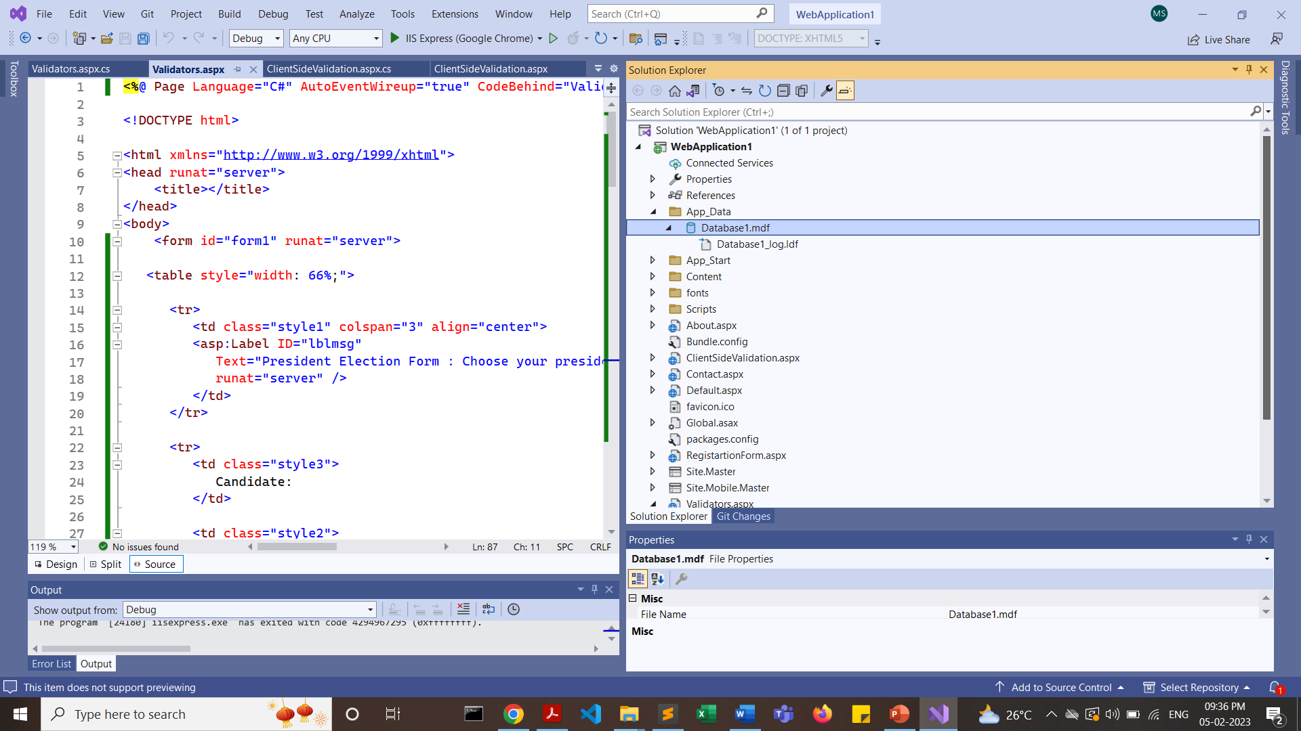
It will create “Database1.mdf” file inside App_Data folder

Slide 9
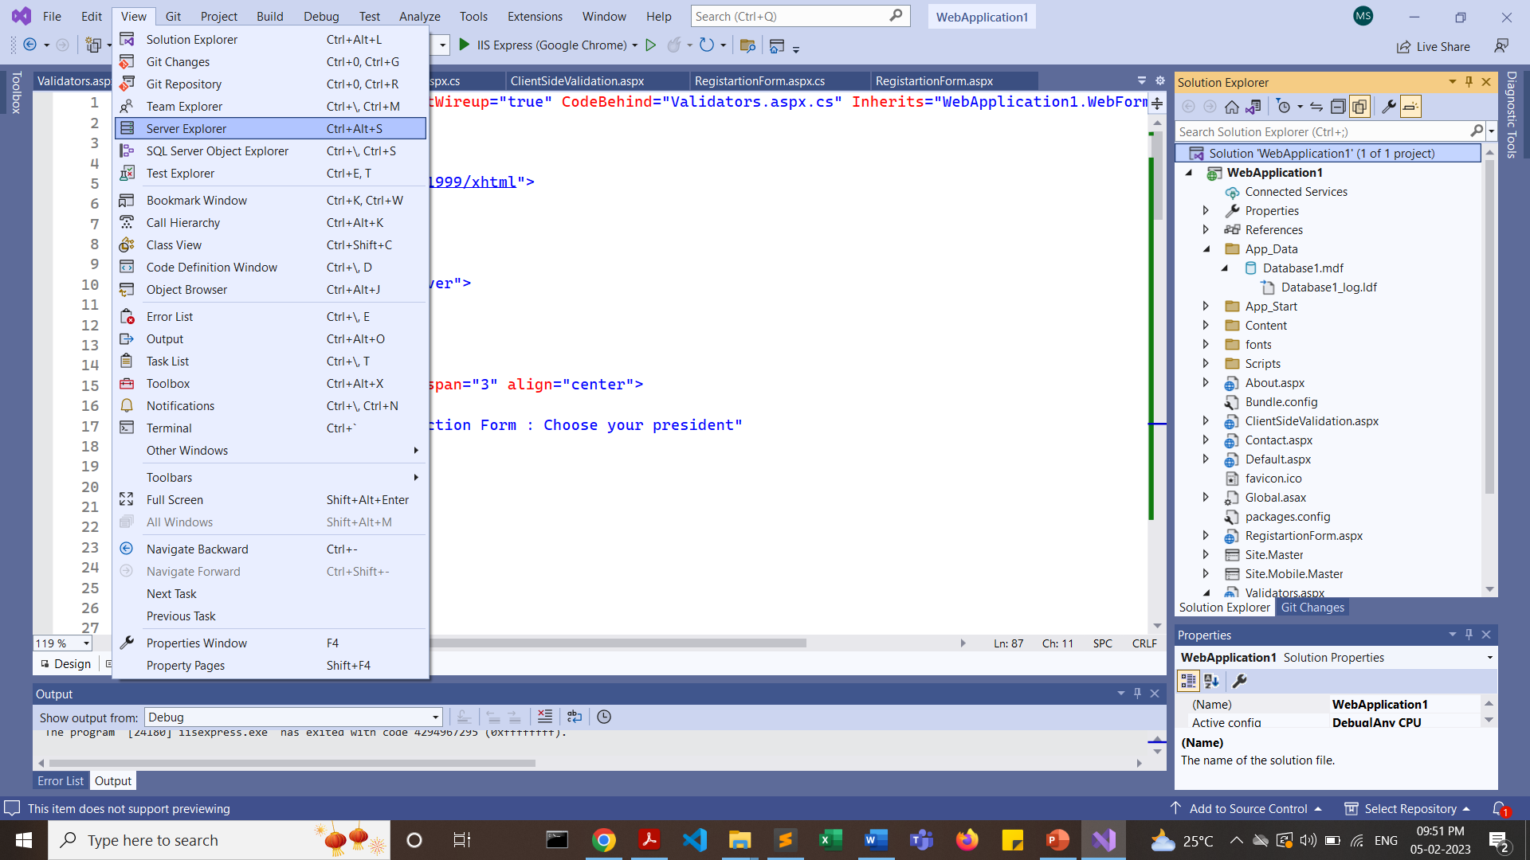
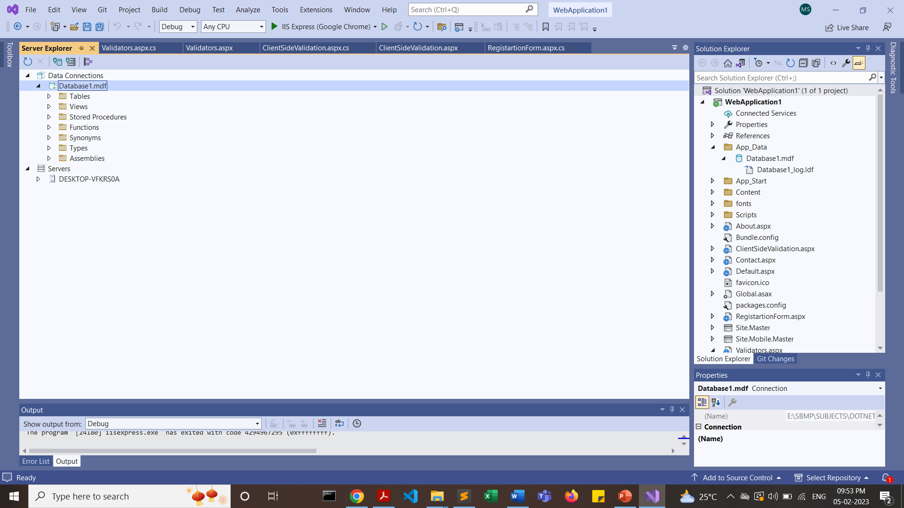
Click on View -> Server Explorer
Double Click on “Database1.mdf” file

Slide 10
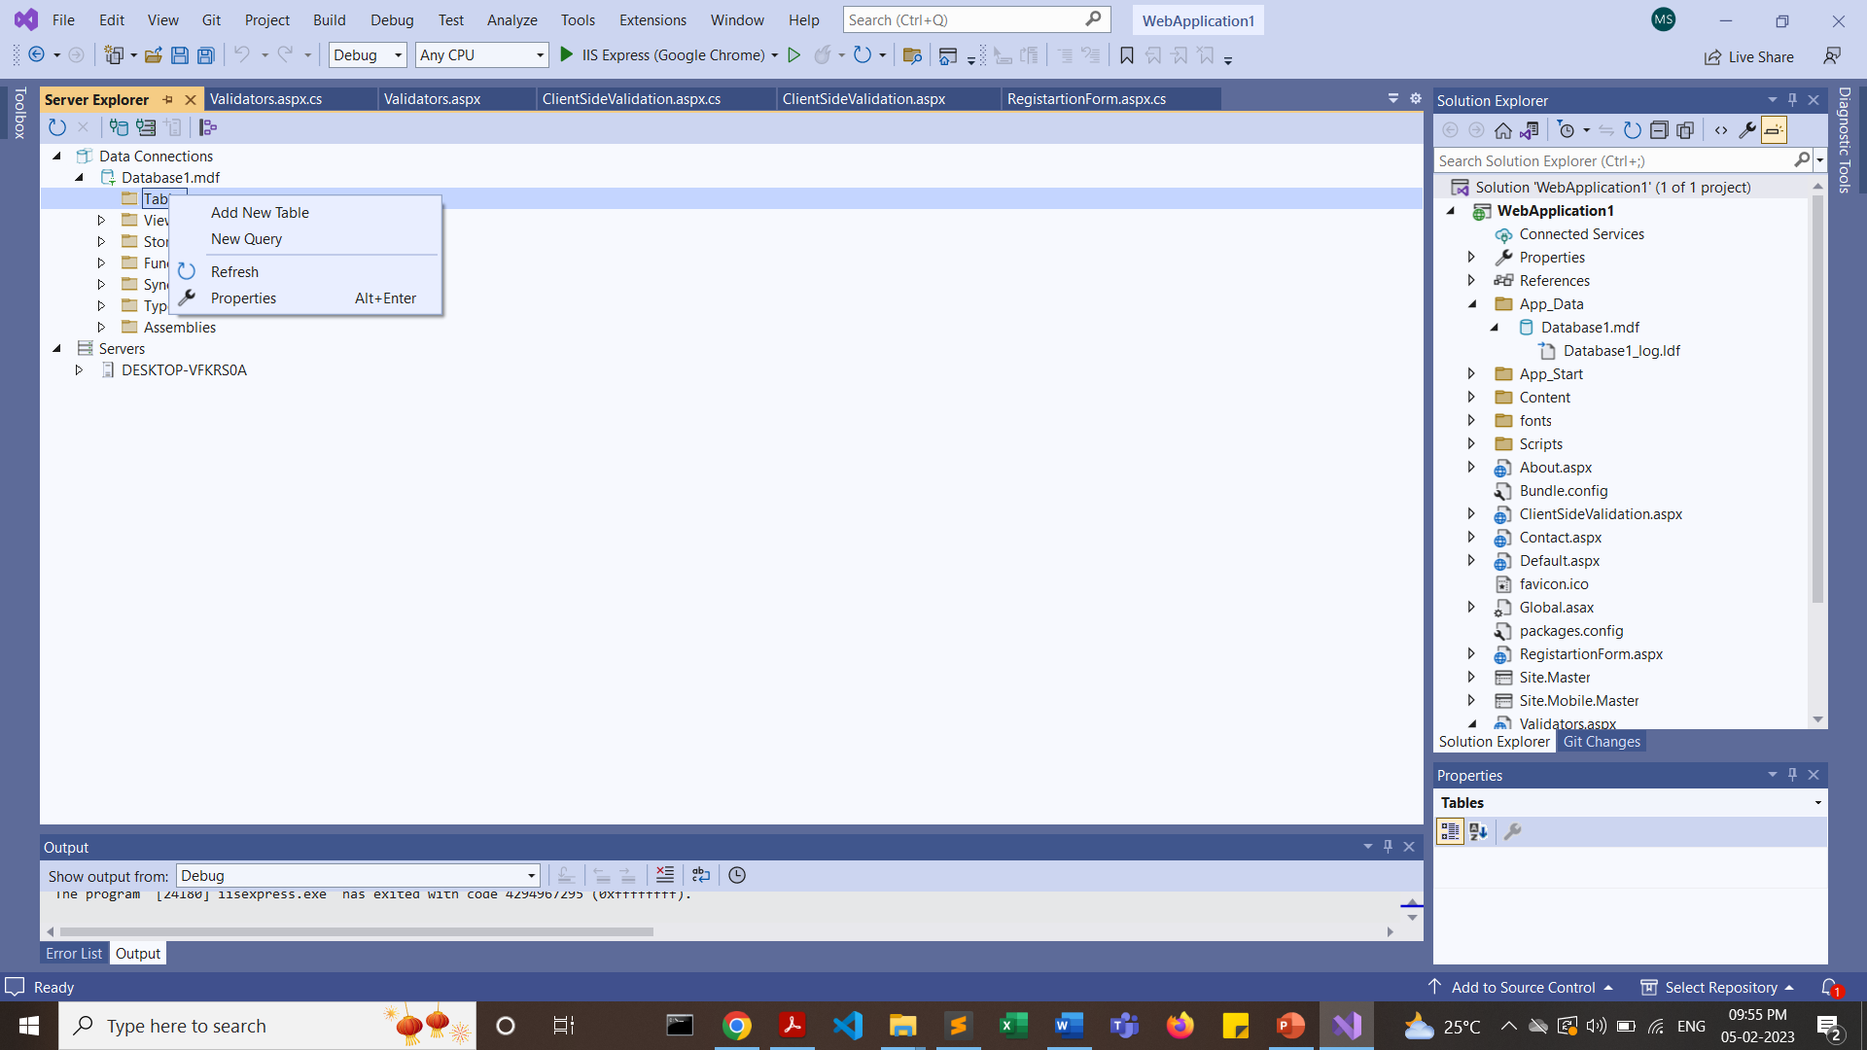
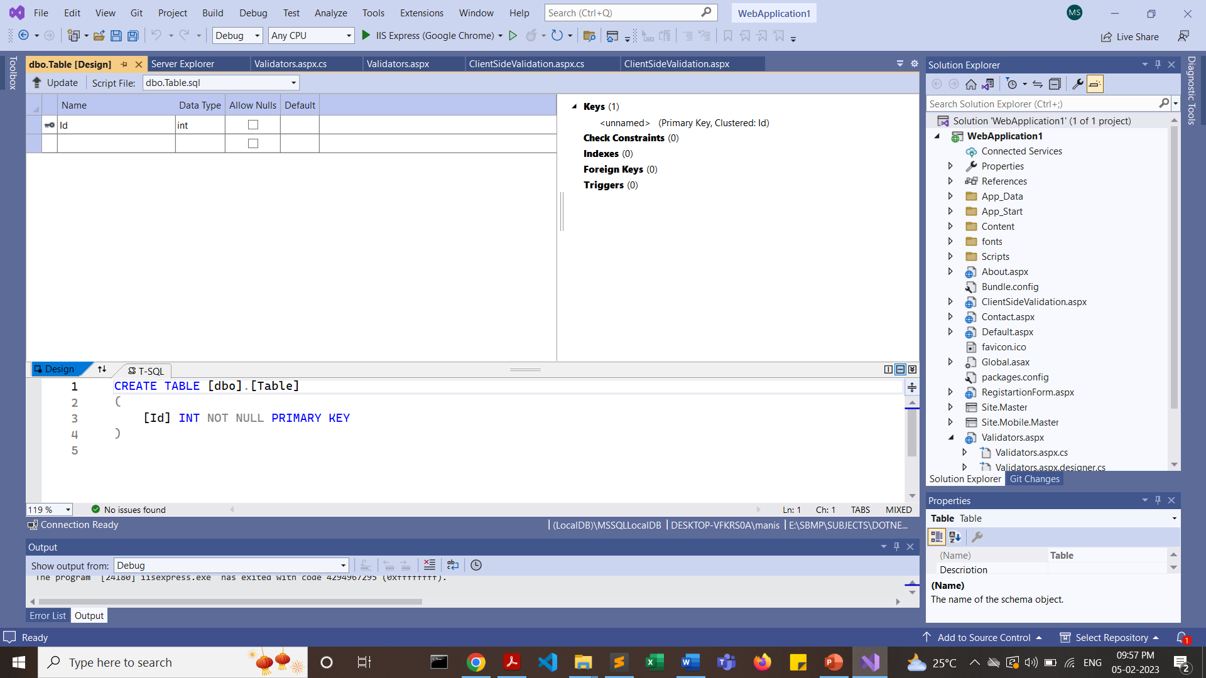
Right Click on “Tables” and click “Add New Table”

Slide 11
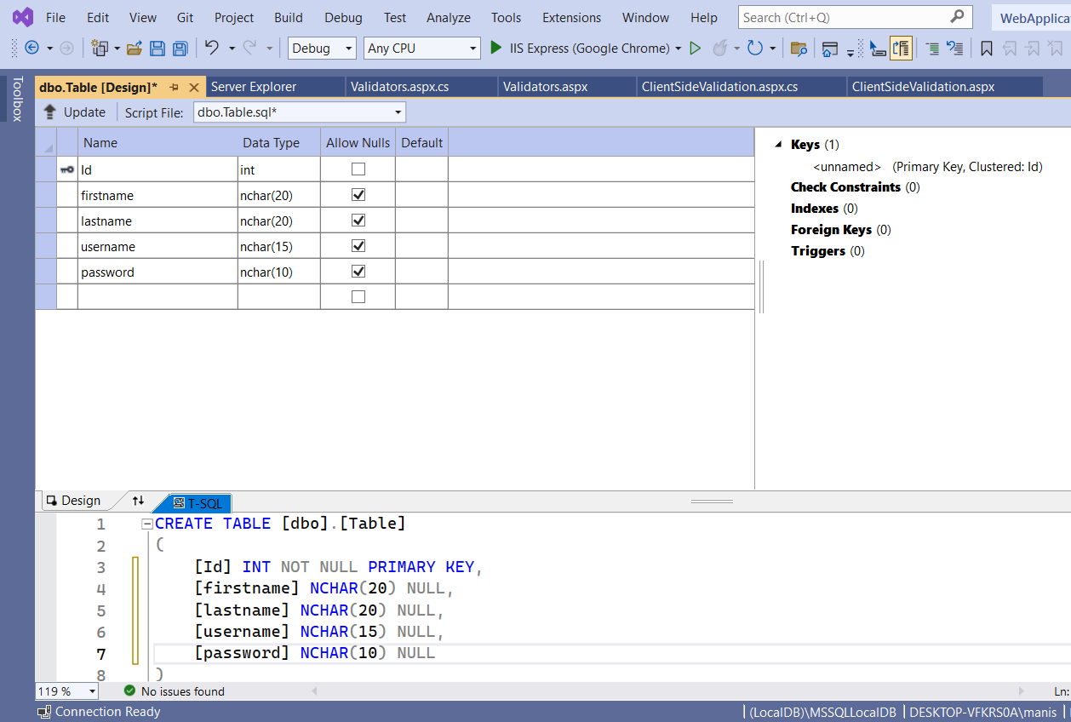
Click on “Update” button

Slide 12
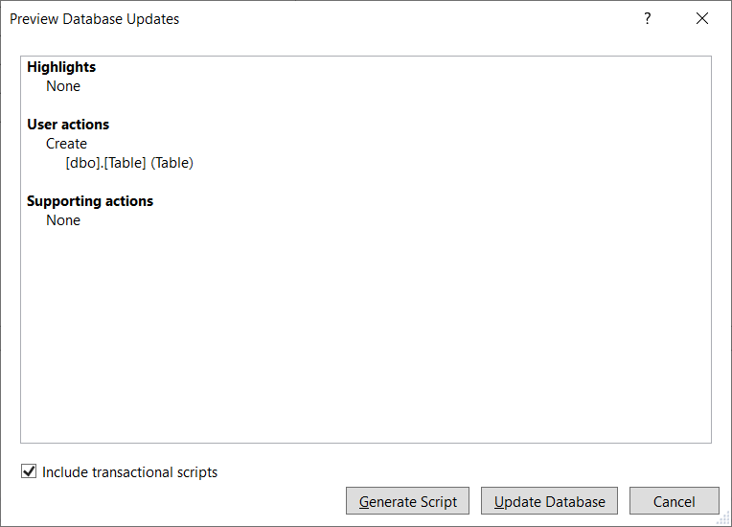
Click on “Update Database” button

Slide 13
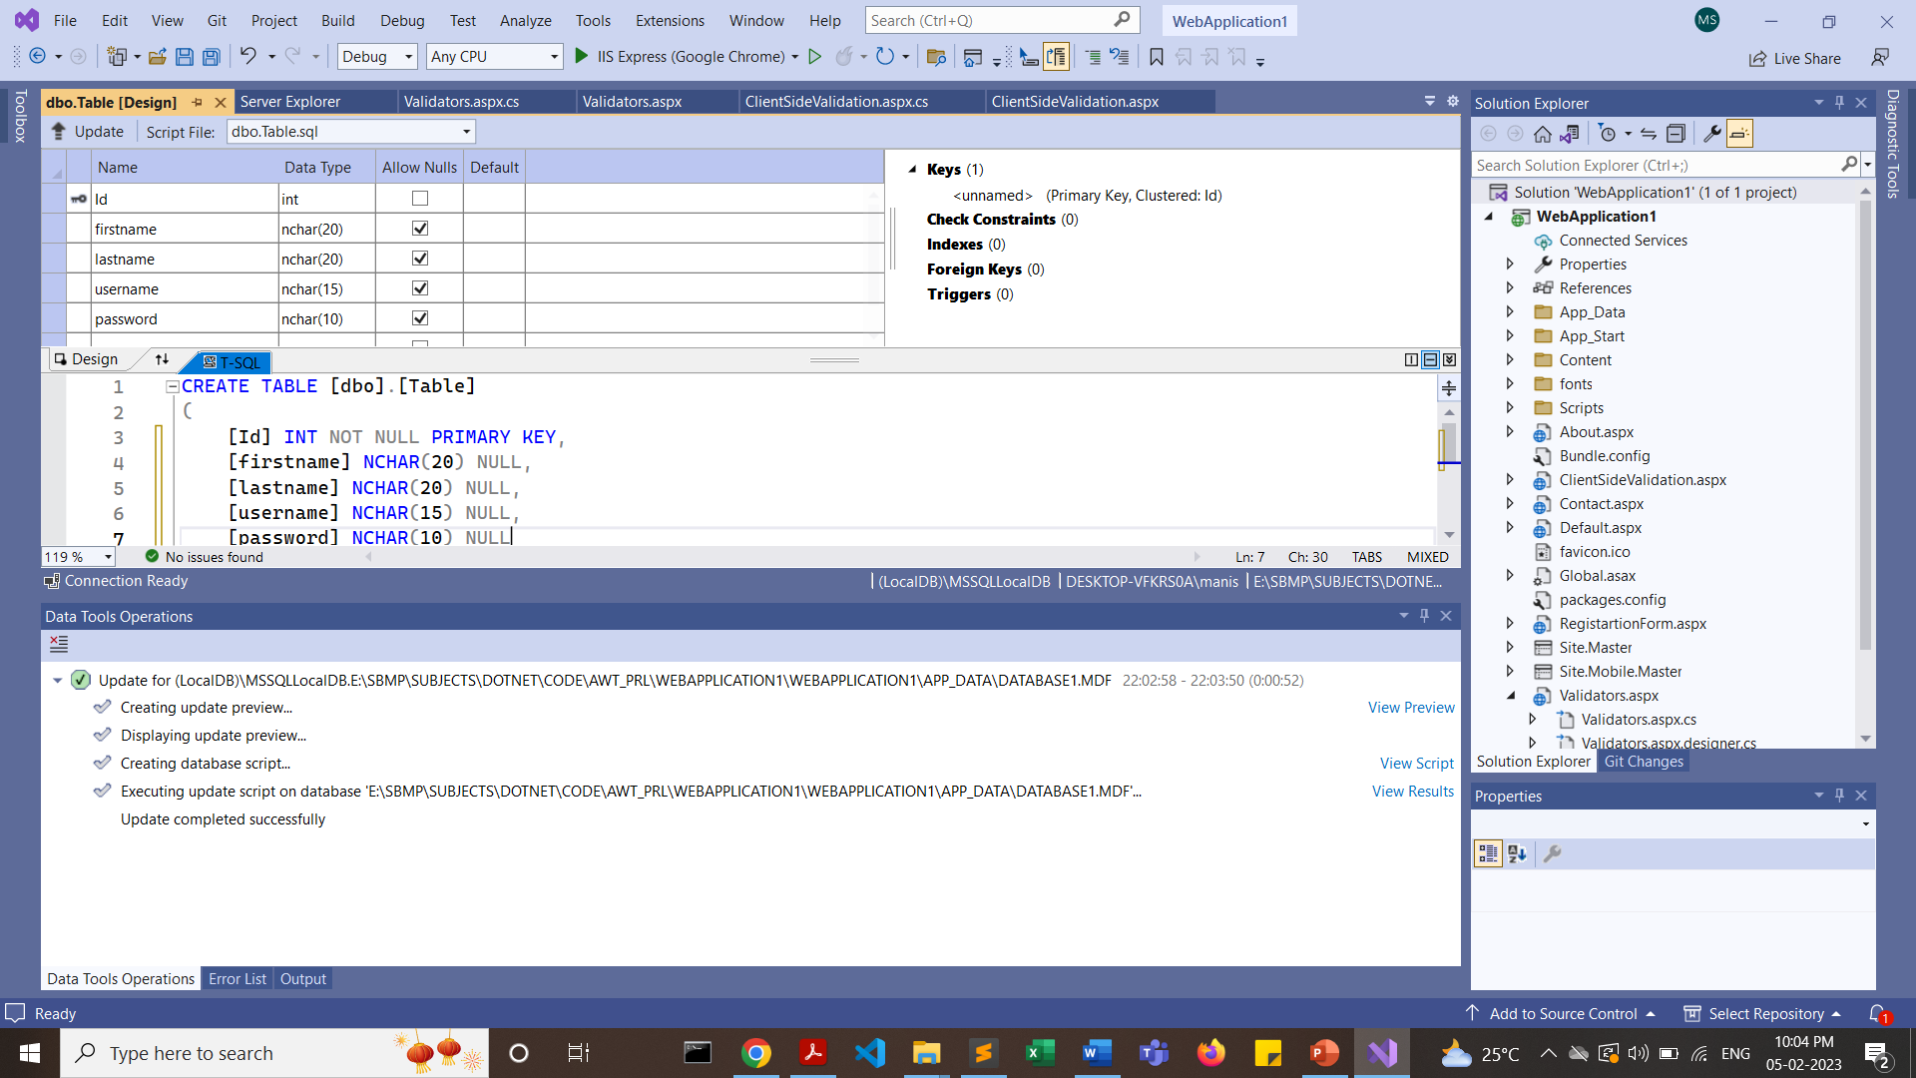

Slide 14
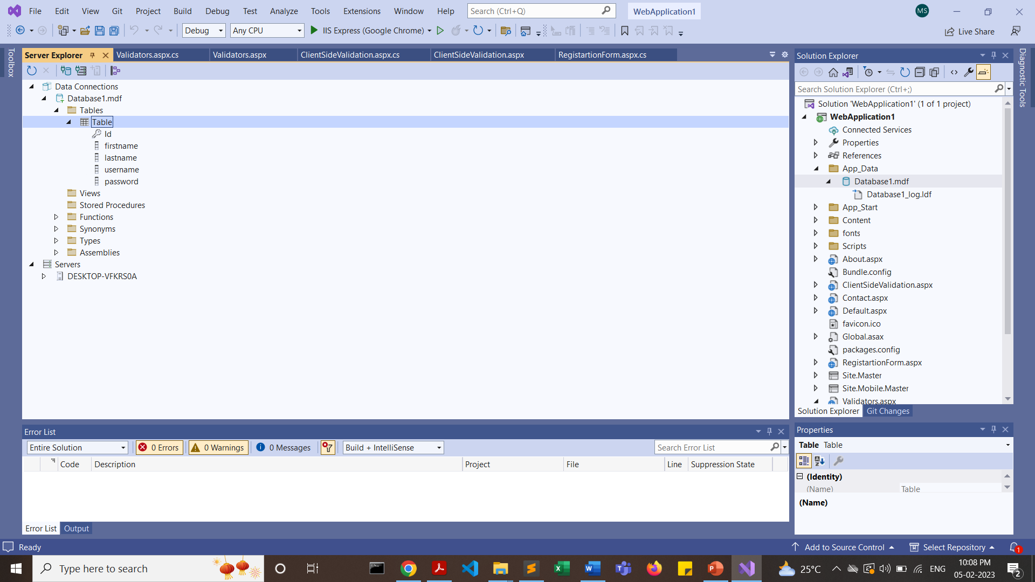
In Server Explorer, right click on Database1.mdf and click on Refresh
Expand the Table

Slide 15
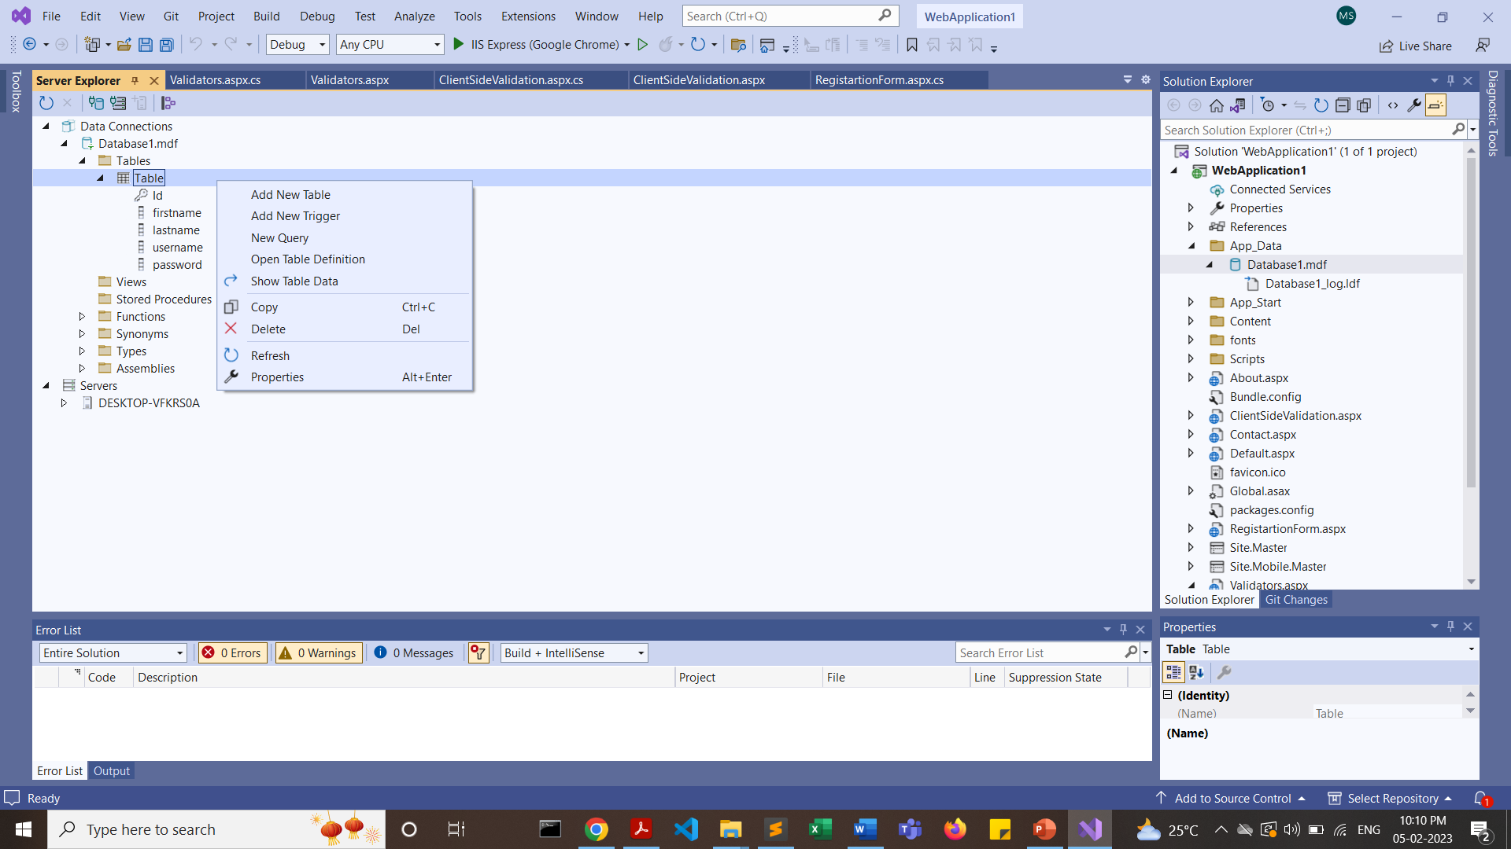
Right Click on Table and Click on “Show Table Data”

Slide 16
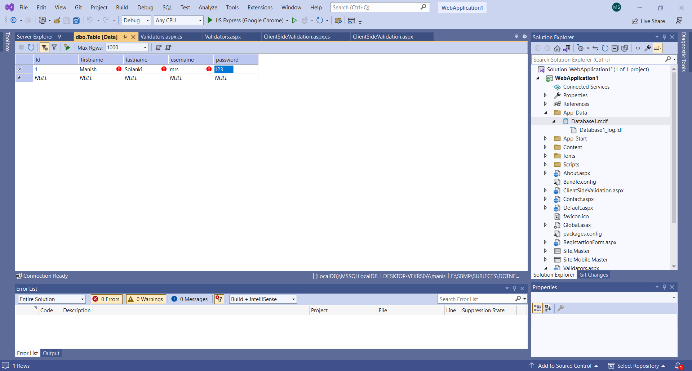
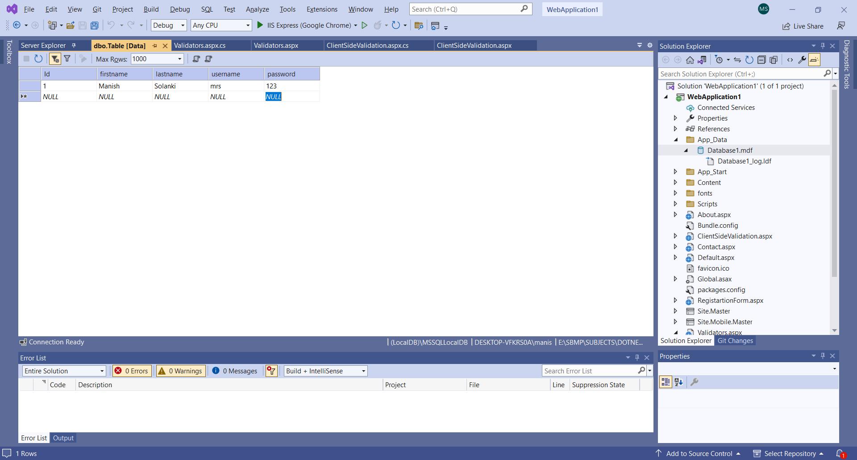
After Entering first row press Enter Key

Slide 18
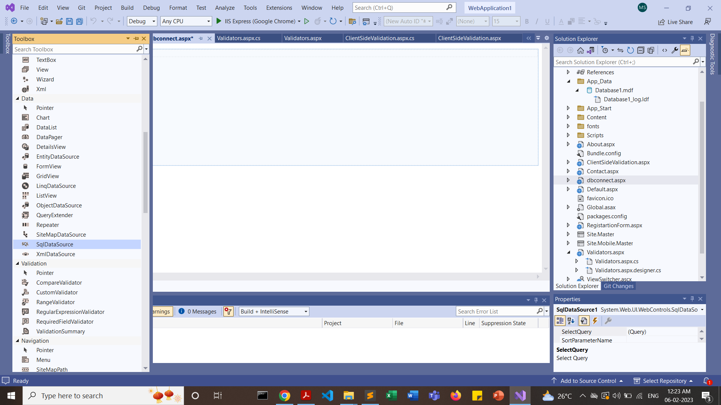
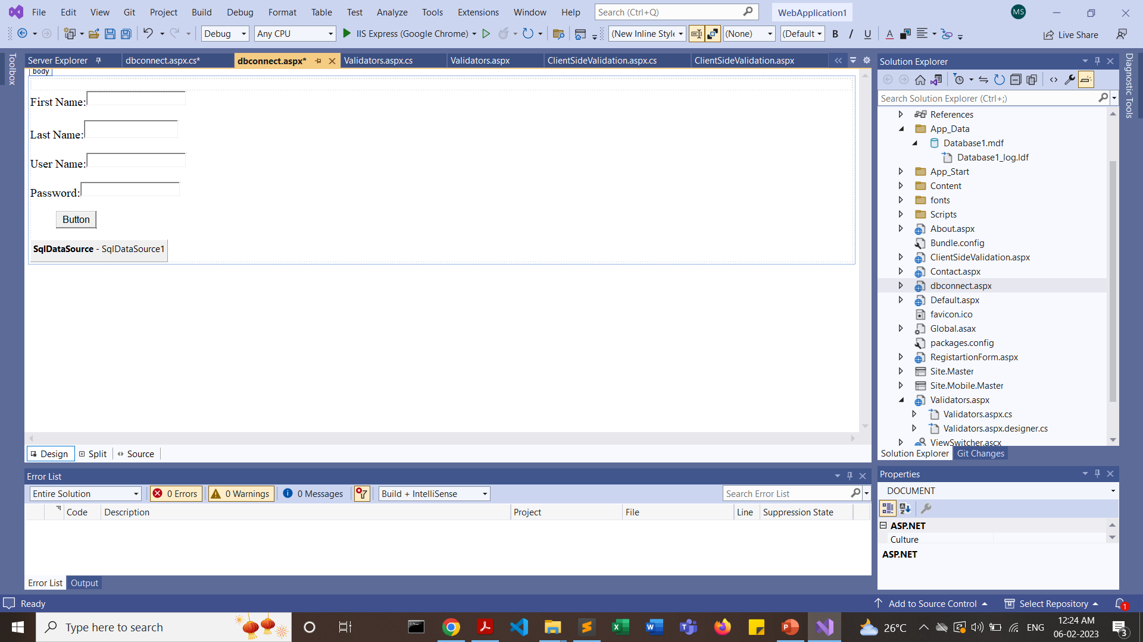
Right Click on “SqlDataSource” and click on “Configure Data Source”

Slide 19
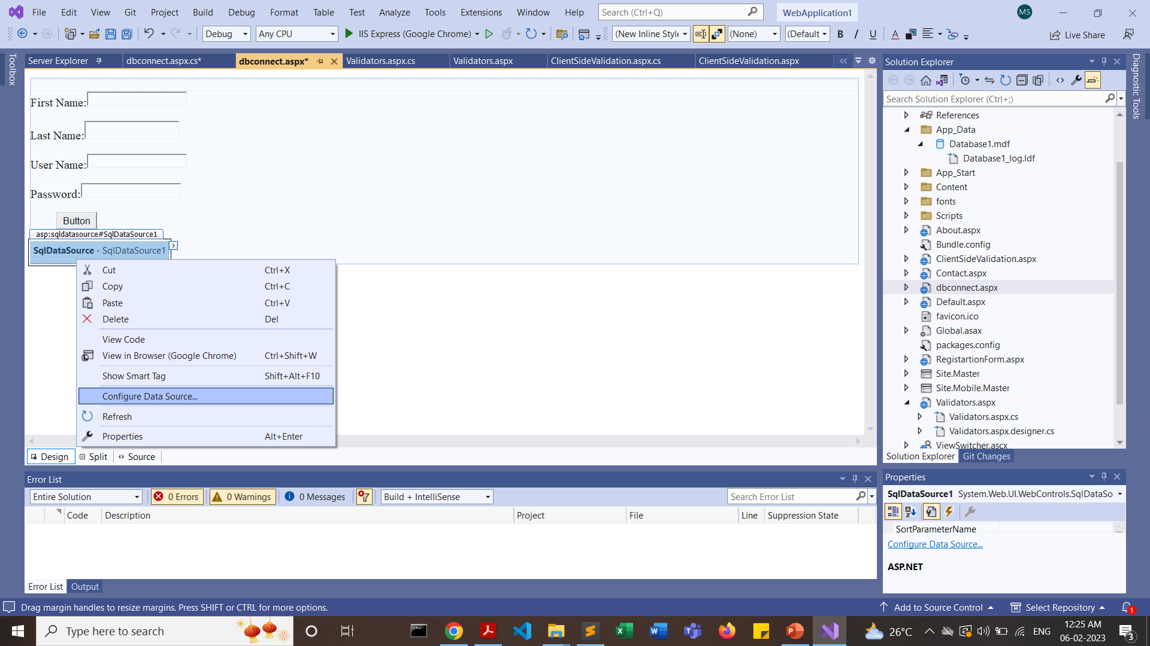

Slide 20
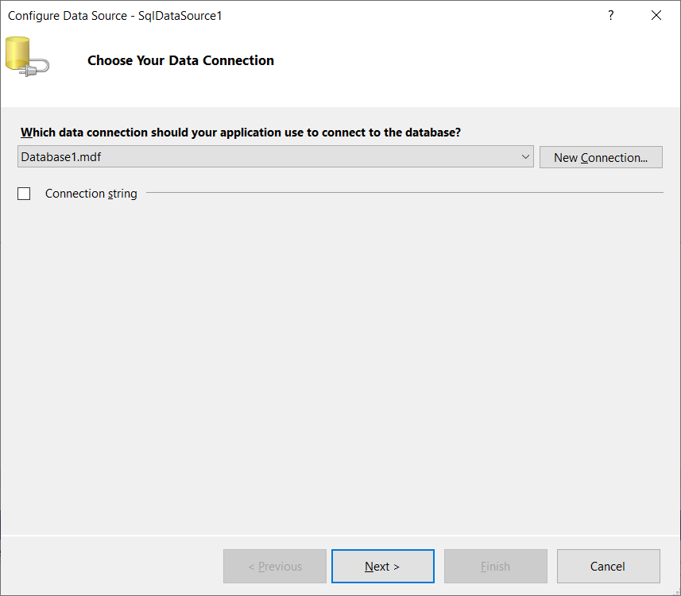
Click on DropDown and select the database name

Slide 21
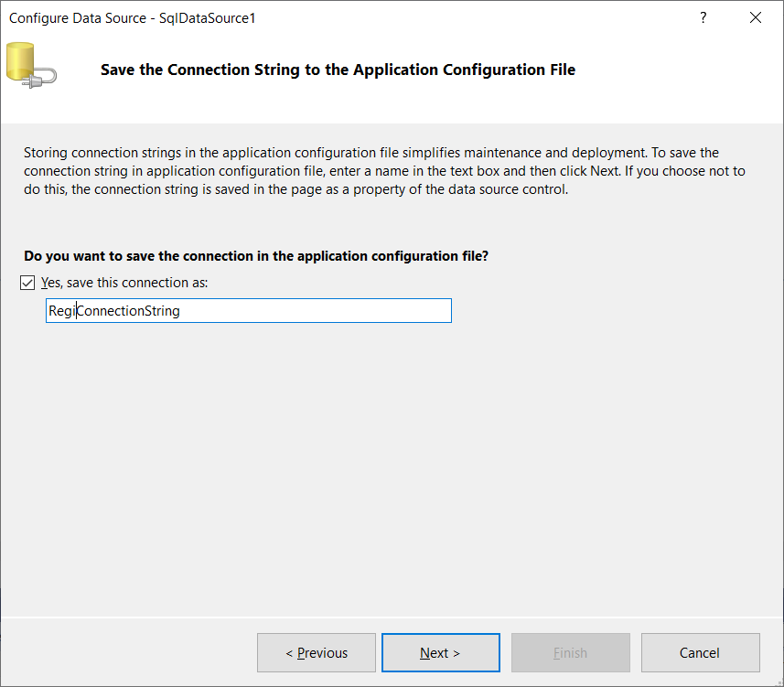

Slide 22
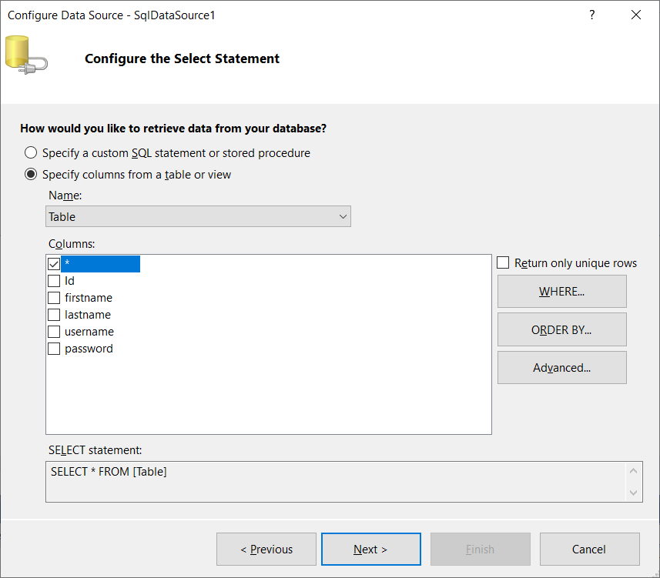

Slide 23
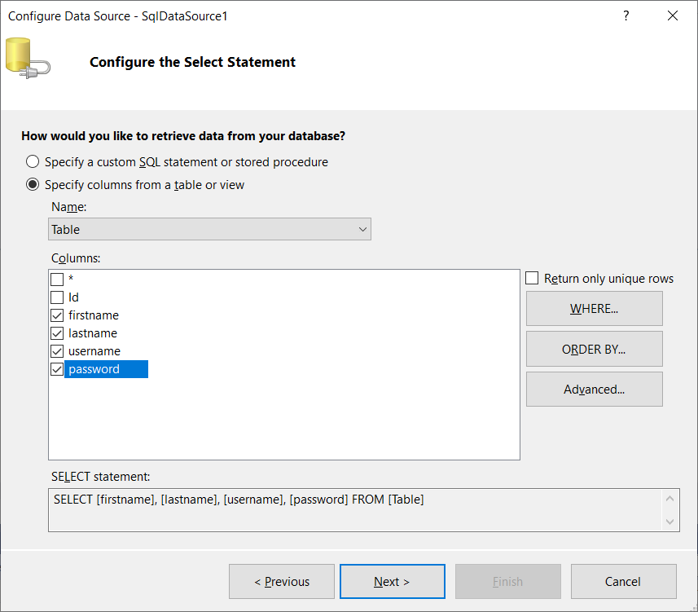
Select the table and its fields

Slide 24
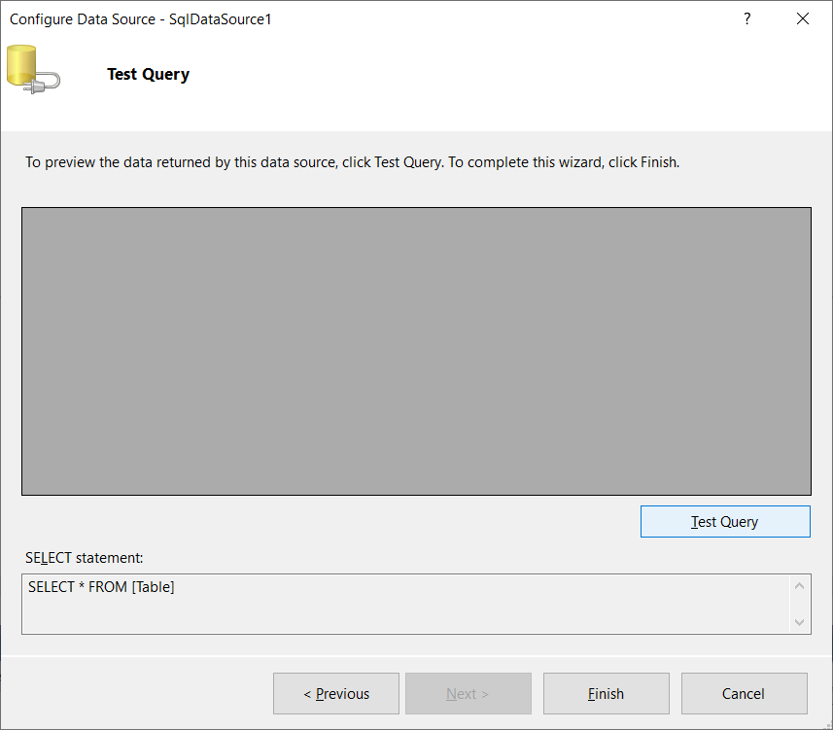
Click on “Test Query”

Slide 25
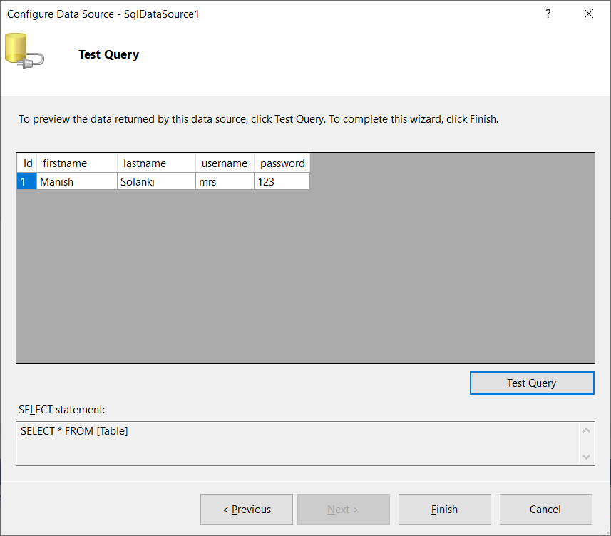
Click on “Finish”

Slide 26
protected void Button1_Click(object sender, EventArgs e)
{
try
{
SqlConnection conn = new SqlConnection(ConfigurationManager.ConnectionStrings["RegiConnectionString"].ConnectionString);
conn.Open();
string insertQuery = "insert into users(firstName,lastname,username,password) values (@firstname,@lastname,@username,@password)";
SqlCommand cmd = new SqlCommand(insertQuery, conn);
cmd.Parameters.AddWithValue("@firstname", TextBox1.Text);
cmd.Parameters.AddWithValue("@lastname", TextBox2.Text);
cmd.Parameters.AddWithValue("@username", TextBox3.Text);
cmd.Parameters.AddWithValue("@password", TextBox4.Text);
cmd.ExecuteNonQuery();
Response.Write("User registeration done Successfully!!!thank you");
conn.Close();
}
catch (Exception ex)
{
Response.Write("error" + ex.ToString());
}
} // end of Button1_Click method

Slide 27
<%@ Page Language="C#" AutoEventWireup="true" CodeBehind="dbconnect.aspx.cs" Inherits="WebApplication1.dbconnect" %>
<!DOCTYPE html>
<html xmlns="http://www.w3.org/1999/xhtml">
<head runat="server">
<title></title></head>
<body>
<form id="form1" runat="server">
<div>
</div>
<asp:Label ID="Label1" runat="server" Text="Label">First Name:</asp:Label>
<asp:TextBox ID="TextBox1" runat="server"></asp:TextBox>
<p>
<asp:Label ID="Label2" runat="server" Text="Label">Last Name:</asp:Label>
<asp:TextBox ID="TextBox2" runat="server" Height="25px" Width="151px"></asp:TextBox>
</p>
<asp:Label ID="Label3" runat="server" Text="Label">User Name:</asp:Label>
<asp:TextBox ID="TextBox3" runat="server"></asp:TextBox>
<p>
<asp:Label ID="Label4" runat="server" Text="Label">Password:</asp:Label>
<asp:TextBox ID="TextBox4" runat="server"></asp:TextBox>
</p>
<p>
<asp:Button ID="Button1" runat="server" style="margin-left: 43px" Text="Button" OnClick="Button1_Click"/>
</p>
<asp:SqlDataSource ID="SqlDataSource1" runat="server" ConnectionString="<%$ ConnectionStrings:RegiConnectionString %>" OnSelecting="SqlDataSource1_Selecting" SelectCommand="SELECT * FROM [Table]"></asp:SqlDataSource>
</form>
</body>
</html>

Slide 28
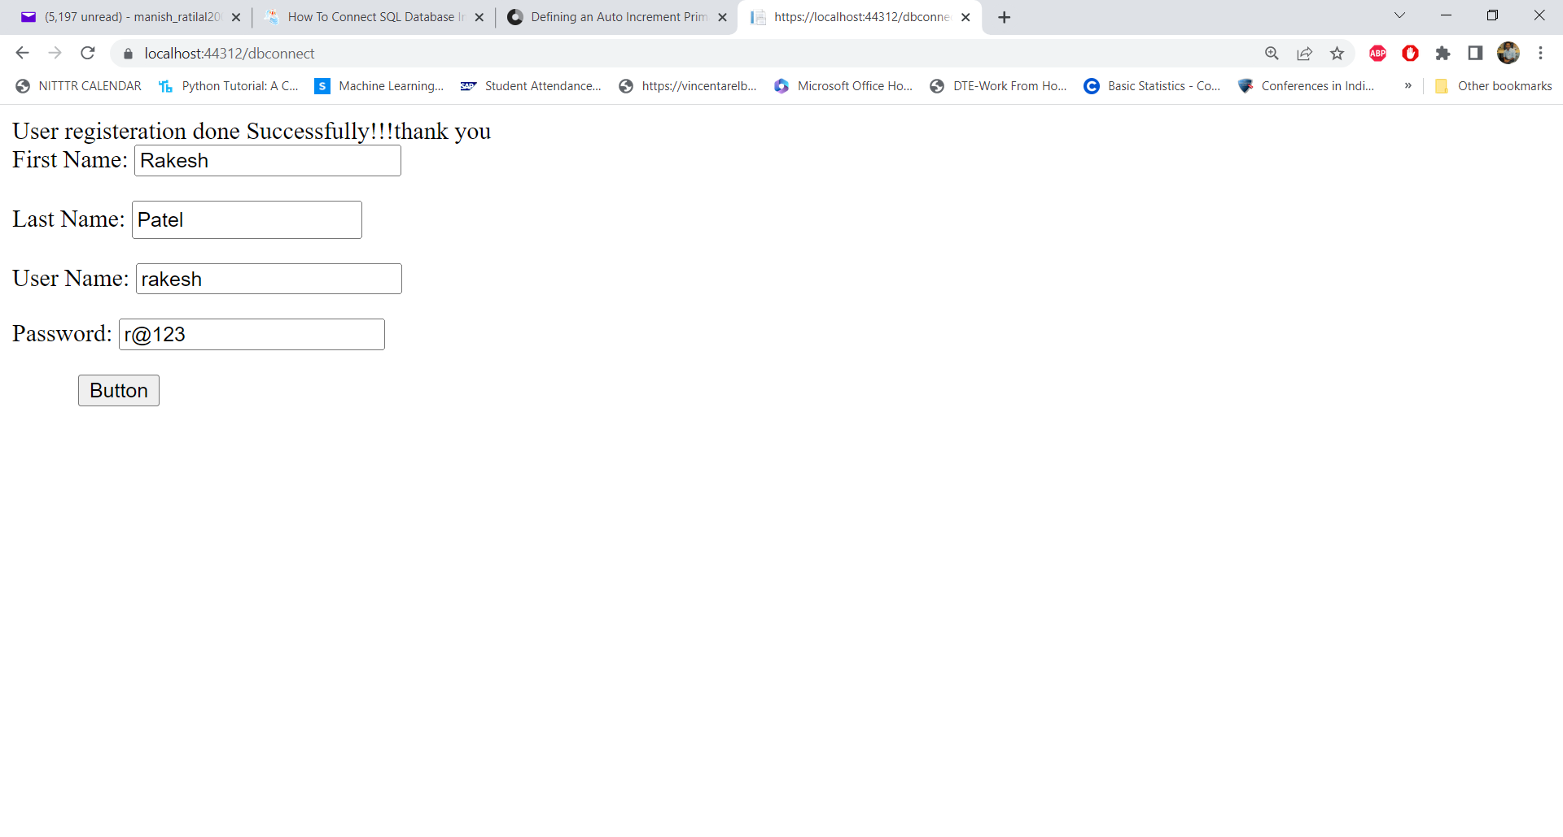

Slide 29
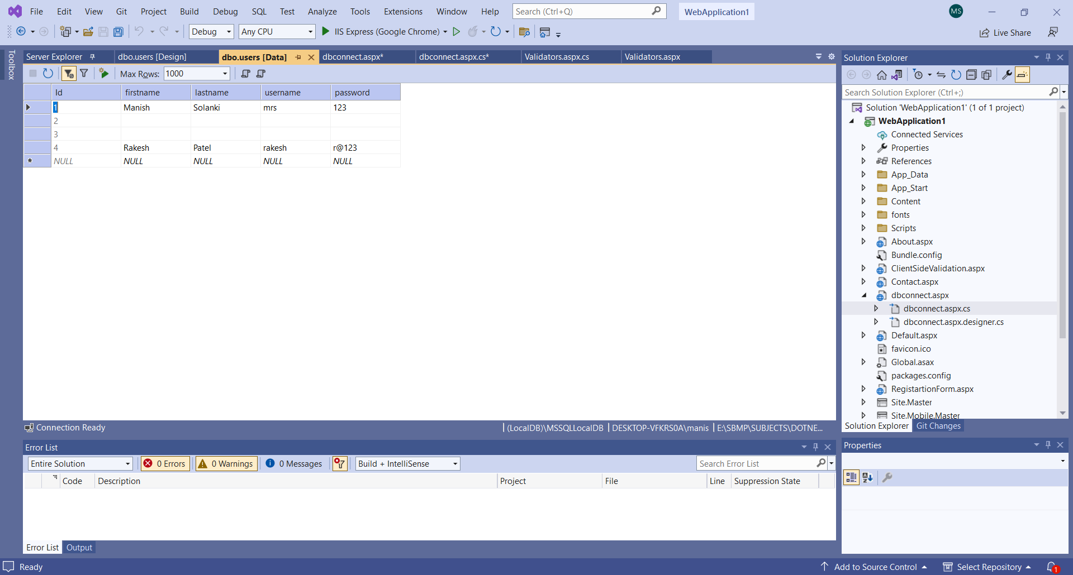
Database Entries

Slide 31
https://www.c-sharpcorner.com/article/how-to-connect-sql-database-in-asp-net-using-c-sharp-and-insert-and-view-the-data-usi/

Slide 36
Thanks!
Any questions?
You can find me at:
manish_ratilal2002@yahoo.com

Slide 37
Credits
https://www.c-sharpcorner.com/article/how-to-connect-sql-database-in-asp-net-using-c-sharp-and-insert-and-view-the-data-usi/
Video Tutorial https://www.youtube.com/watch?v=M0vvS5woWIo&ab_channel=BoostMyTool

